Slide 1

PCWG 2016 Update
10th August 2016
NREL, Colorado, US
Peter Stuart

Slide 2
PCWG 2016 Roadmap Preparation Process
Online Survey (November 2015)
Online Survey Results Presentation and Group Discussion (December 2015)
Preparation of roadmap based on survey results and discussion (January 2016)
Circulation of Draft Roadmap (February 2016)
Email Feedback (February 2016)
Roadmap Finalised (March 2016)

Slide 3
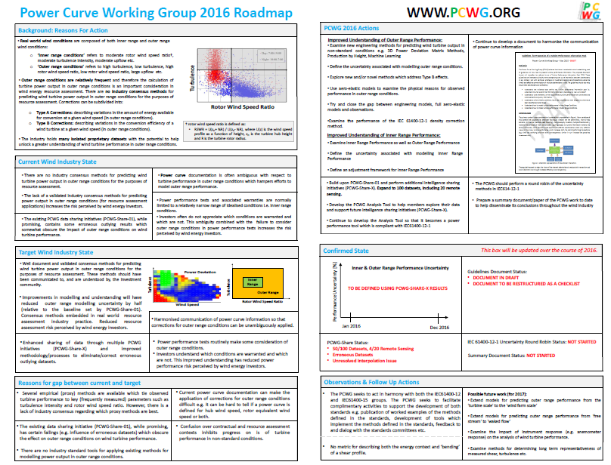

Slide 4
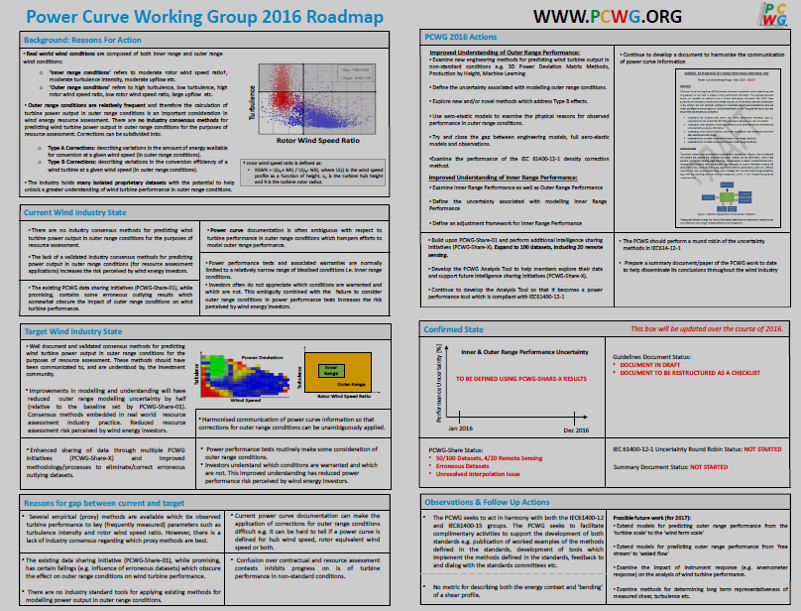
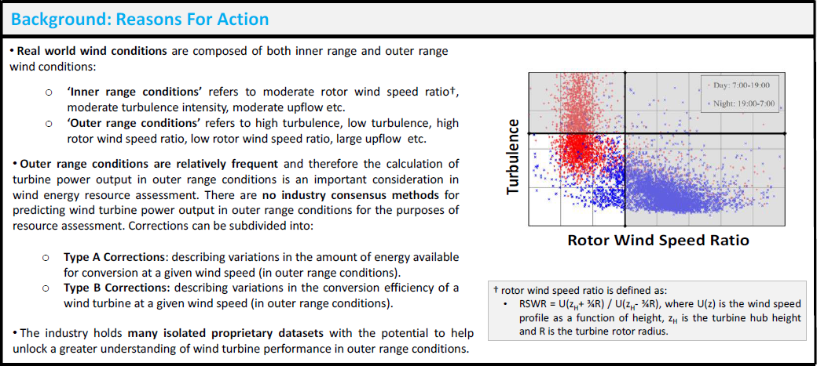

Slide 5
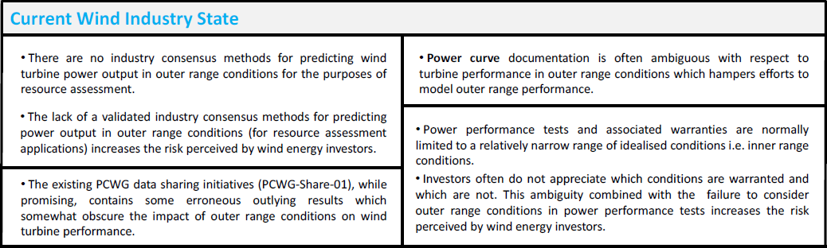

Slide 6
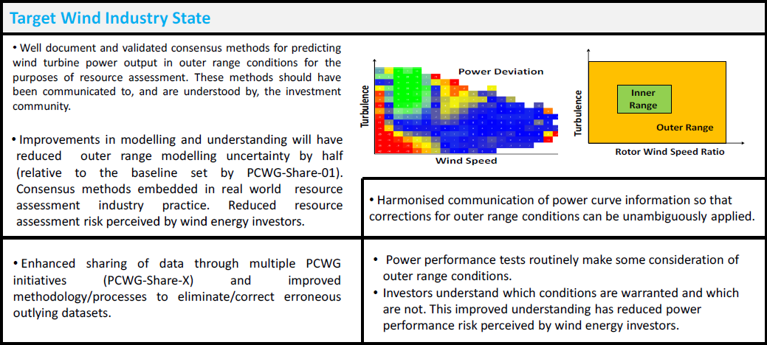

Slide 7
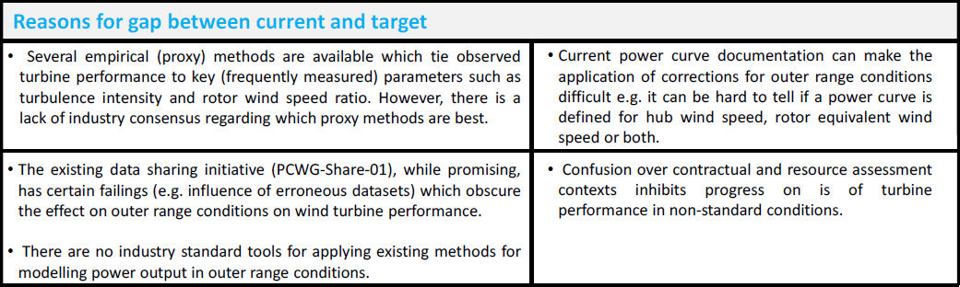

Slide 8
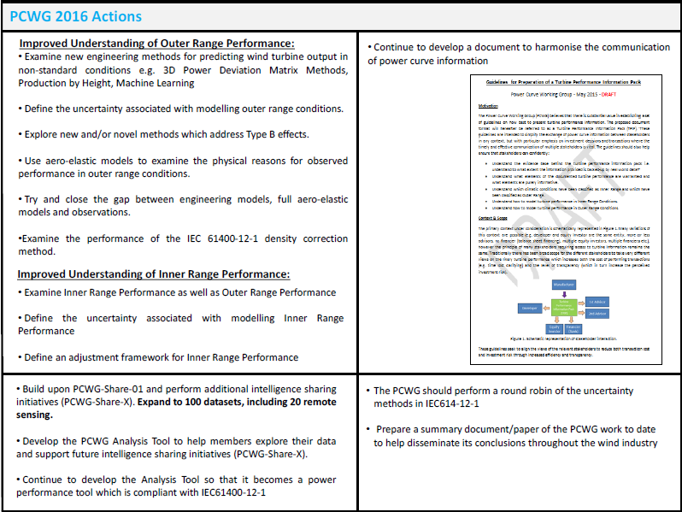

Slide 9
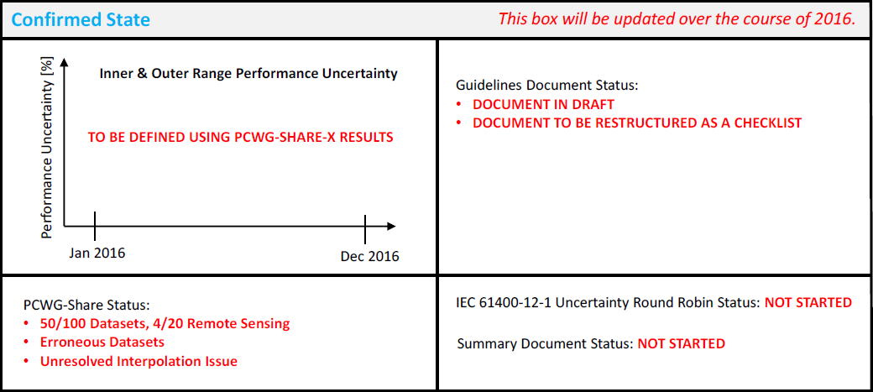

Slide 10
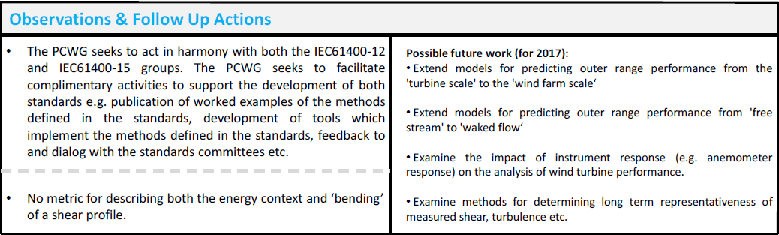

Slide 11
Join the Power Curve Working Group at: www.pcwg.org

